Slide 1

Prediction in Cryptocurrency Trading: A Random Forest Learning

Slide 2
CONTENTS:
Covered Topics
Problem Statement
Introducation
Results
Related Work
Future work

Slide 3
Introduction:
The objective of this project is to create and assess a trading strategy using pre-selected technical indicators from a dataset. The Random Forest algorithm is specifically used in the proposed Candle Strength approach to produce superior results and collect insightful data for bitcoin trading.

Slide 4
Related Work:
1- Crypto-Currency price prediction using Decision Tree and Regression techniques.
“price forecast for five days is done using Decision Tree and Linear regression models. The experimental study results show that linear regression outperforms the other by high accuracy on price prediction.”
2- PREDICTING TREND IN STOCK MARKET EXCHANGE USING MACHINE LEARNING CLASSIFIERS .
“observed from our experimental results and graphs that KNN has highest Accuracy and lowest MAE and it shows that it is the best classifier in terms of accuracy and MAE for prediction as compared to SVM and Naïve Bayes. Our experimental results also show that SVM is a second best classifier for stock”
3- There was also work using text data from social media Media platforms and other sources of bitcoin price
prediction.

Slide 5
Problem Statement:
First, it aims to address the challenge of formulating a trading strategy that can effectively analyse market data, identify patterns, and generate trading signals.
Second, it aims to tackle the problem of training the trading strategy using historical data in order to optimize its parameters, fine-tune its decision-making process, and improve its overall performance.
By combining strategy development, training, and testing, your project aims to solve the problem of developing a robust and profitable trading strategy that can adapt to changing market conditions and generate successful trading outcomes.

Slide 6
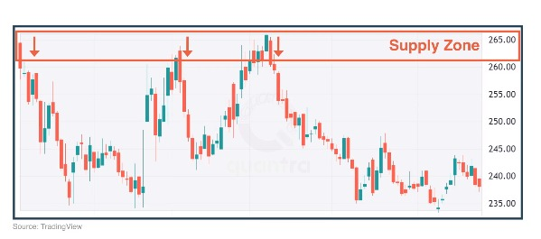
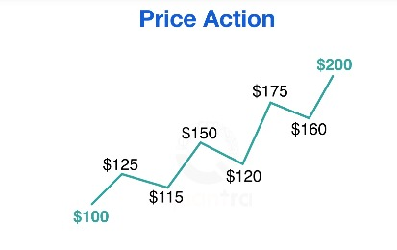
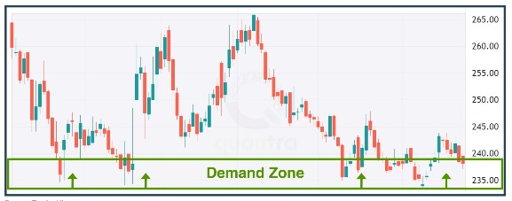
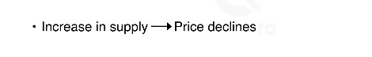
Supply and Demand:

Slide 7

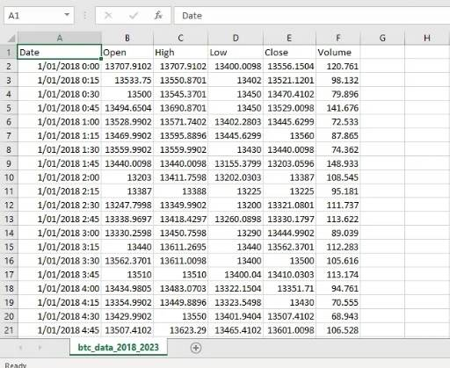
Bitcoin Data
We imported this data from Binance a site.
The data was divided two groups
1. 2018 – 2022(Train data)
2. 2022 – 2023 (Test data)

Slide 8
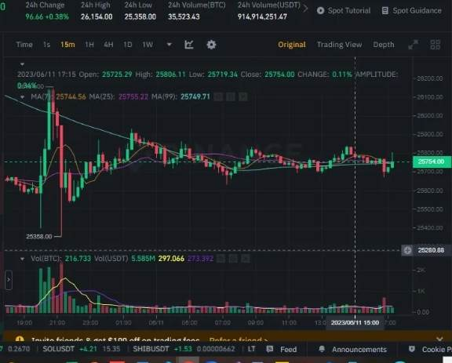
Candle Strength Strategy
Trading approach applied to 15-minute Bitcoin data.

Slide 9
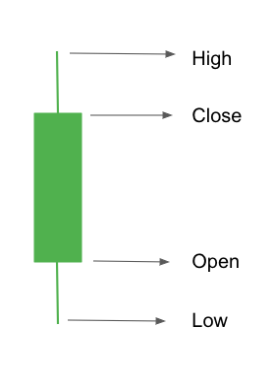
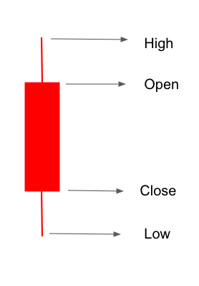

Slide 10
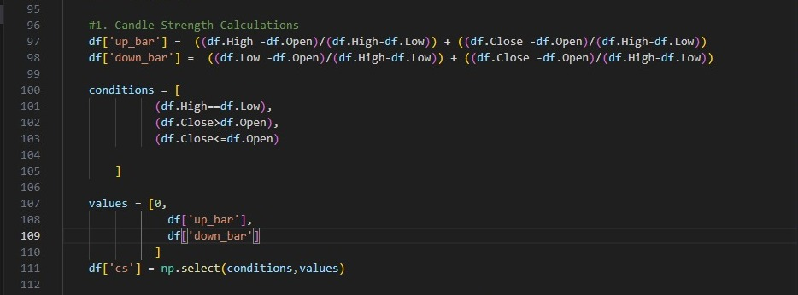
Candle Strength Calculations:

Slide 11
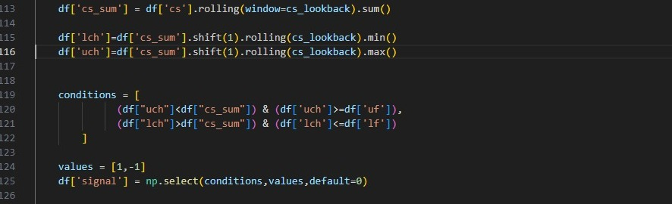
Candle Strength Calculations:

Slide 12
Profit and Loss(pnl)
we record information such as entry price, entry time, exit price, and exit time. This information is used to understand the performance of trading strategy by calculating metrics such as profit and loss (PnL), returns.
We can calculate the profit and loss (PnL) of the trades generated by the SMA and price cross strategy.
PnL = (Exit price - Entry price) * Size

Slide 13
we will find the number of winners and losers. Trades that gave us a profit i.e. Pnl>0 are winning trades. Trades that gave us a loss or no profit i.e. Pnl<=0 are losing trades

Slide 14
Indicators:
We used the indicators to create a trading strategy.

Slide 15
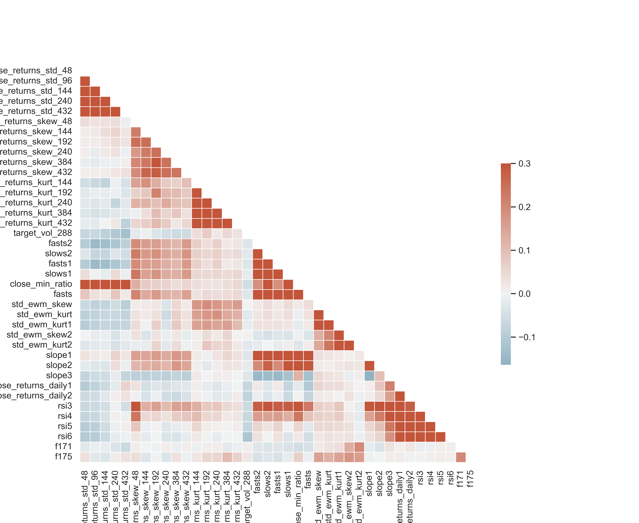
Diagonal Correlation Matrix:

Slide 16
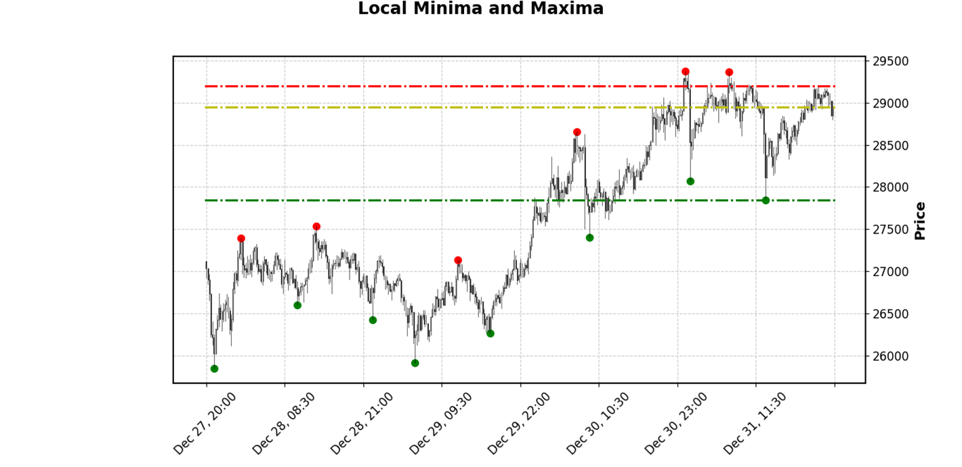
Support & Resistance:
Support and resistance is used to identify price levels at which the price of an asset is likely to stop and reverse. Here is an example implementation of support indicator using Python and pandas library:
Takes two inputs: data, which is a pandas DataFrame containing price data, and w, which represents the number of periods to consider for identifying support and resistance levels.

Slide 17
When the price approaches a support level, it may bounce back and start rising, indicating a potential buying opportunity.
when the price approaches a resistance level, it may reverse and start declining, indicating a potential selling opportunity.
If the price consistently bounces off a support level and it suggests an uptrend.
if the price consistently fails to break above a resistance level and continues to make lower it suggests a downtrend.
Support and resistance levels can assist in determining appropriate stop-loss levels.
Support and resistance levels can provide logical areas to set stop-loss orders based on the expected behavior of the price.
By analyzing support and resistance levels,They can consider the distance between the entry point and the nearest support or resistance level to determine whether the potential profit justifies the risk. Tighter stop losses can be set if support or resistance .

Slide 18

ATR (Aaverage True Range)
ATR is a volatility indicator that shows us how much an asset may move during a given timeframe.
introducing several other core indicators such as the RSI, ADX and Parabolic SAR
Who to calculate ?
true range = max[(high - low), abs(high - previous close), abs (low - previous close)]

Slide 19
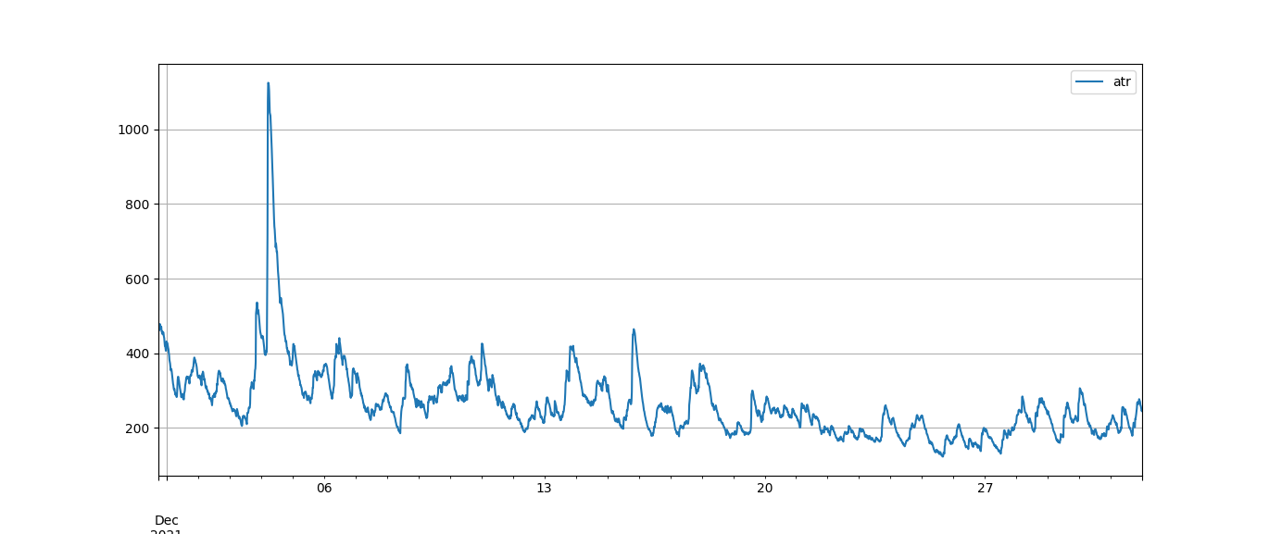

Slide 20
Machine Learning Algorithem:
Support Vector Classifier (SVC)
Decision Tree Classifier
Random Forest Classifier

Slide 21
Random Forest :
we explored several machine learning algorithms, including the Support Vector Classifier (SVC), Decision Tree Classifier, and Random Forest Classifier, to develop a trading strategy. Each algorithm was tested and evaluated based on its performance in predicting market outcomes and generating profitable trading decisions. After thorough analysis and comparison, we found that the Random Forest Classifier algorithm consistently produced the most satisfactory results in terms of accuracy and profitability. Therefore, we concluded that the Random Forest Classifier algorithm is the most suitable choice for our trading strategy, considering its superior performance and predictive capabilities.

Slide 22
Random Forest :
The random forest algorithm was chosen over the LSTM algorithm because it is less prone to overfitting. The candle strength strategy is a relatively simple trading strategy, and the random forest algorithm was able to learn the nuances of the strategy without overfitting.

Slide 23
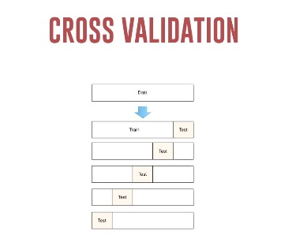

Slide 24
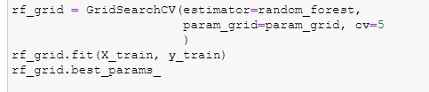
hyperparameter tuning

Slide 25
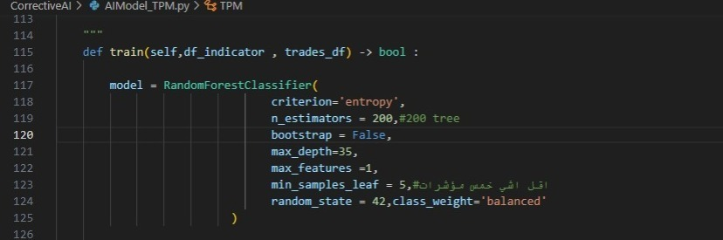

Slide 26
Train data :
Test data began on 1,2, 2018, at 00:00:00
Ended on 31/12/2021 11:45:00
# Trades = 1577
Win Rate [%] = 36.2714013950539
Best Trade [%] = 28.1957543874124
Worst Trade [%] = -8.93488739180861

Slide 27
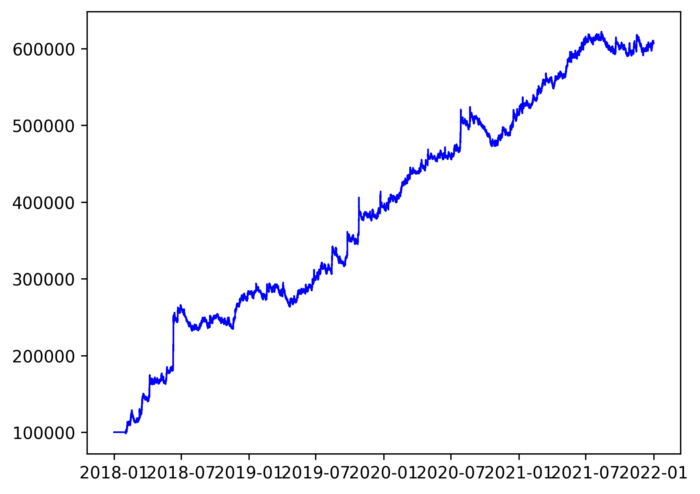

Slide 28
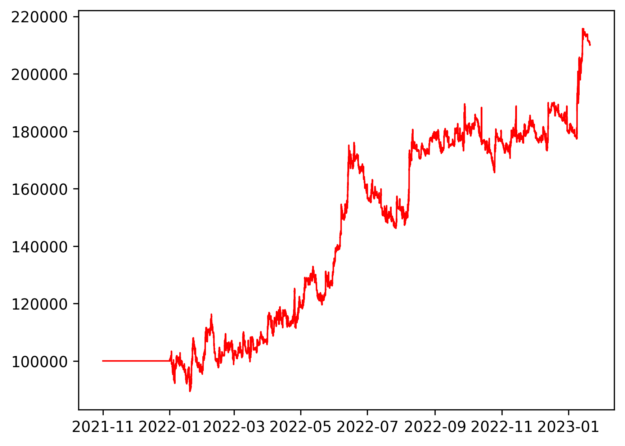
Test data with AI:
The trading strategy was able to calculate the percentage
of risk for each trade after utilizing the machine intelligence
model, which resulted in a higher profit rate.
Test data began on 1,11, 2021, at 00:00:00
Ended on January 20, 2023, at 18:45:00
Total capital at the end of the time period was $210,166.67
# Trades 440
Win Rate [%] 35.0
Best Trade [%] 22.810937
Worst Trade [%] -6.115072
Profit Factor 1.318231

Slide 29
Future work:
To improve trading performance, the next part of this study will make use of reinforcement learning.

Slide 30


